Slide 1


CSE332
Industrial Ethics and Legal Issues
Ethical Behavior of IT Professional

Slide 2
Ethics in Information Technology

Slide 3
ETH ICS IN INFORMATION TECHNOLOGY
Here are some examples that raise public concern about the ethical use of information technology:
Ethical concerns in technology's workplace use.
Copyright violation harms music and films.
Spam emails enable low-cost marketing.
Hacking, plagiarism, and tracking persist. ​

Slide 4

Profession
A profession is a calling that requires specialized knowledge and often long and intensive academic preparation.
Professional ?

Slide 5
Professional Employee
One who is engaged in the performance of work .
Specialized intellectual instruction.
Exercise of discretion and judgement.

Slide 6
Ethical behavior of IT professional

Slide 7


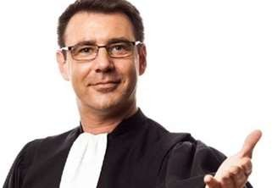
Professionals such as doctors, lawyers, and accountants require advanced training and experience; they must exercise Carefulness and judgment in the course of their work.

Slide 8
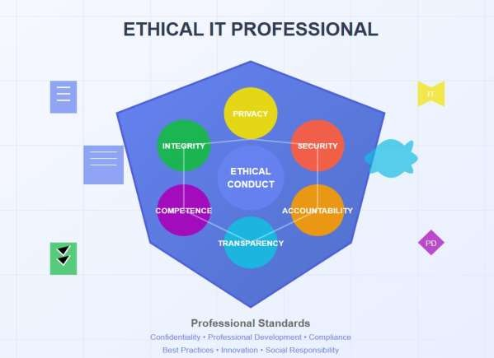

Are IT Workers Professionals?
Specialized Knowledge
Ethical Behaviour
Accountability
Commitment to Continuous Learning

Slide 9
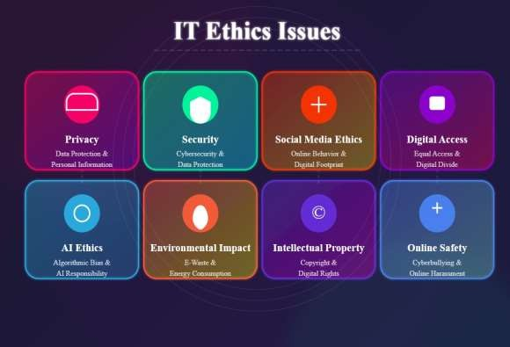
Common Ethical Issues For IT Users
Privacy Concern
Cybersecurity Risks
Misuse of IT Resource
Surveillance and Monitoring

Slide 10
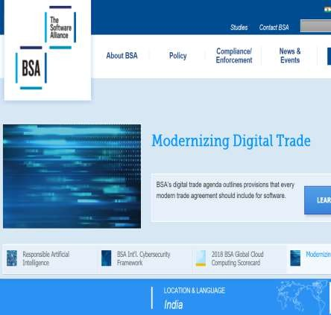
Business Software Alliance (BSA)
The Business Software Alliance
(BSA) is
represents
software
a trade group that the world’s largest and hardware
manufacturers.
Its mission
is to stop the copying of its
unauthorized
software
members.
produced by

Slide 11
More than 100 BSA lawyers and investigators prosecute thousands of cases of software piracy each year.
BSA investigations are usually triggered by calls to the BSA hotline, reports sent to the BSA Web site (www.nopiracy.org), and referrals from member companies.

Slide 12
Supporting the Ethical Practices Of IT
Users

Slide 13

Supporting the Ethical Practices Of IT
Users
Education And Awareness
Clear Policies and Standards
Access Control and Security
Ethical Use Of AI And Automation
Collaboration and community Involvement

Slide 14
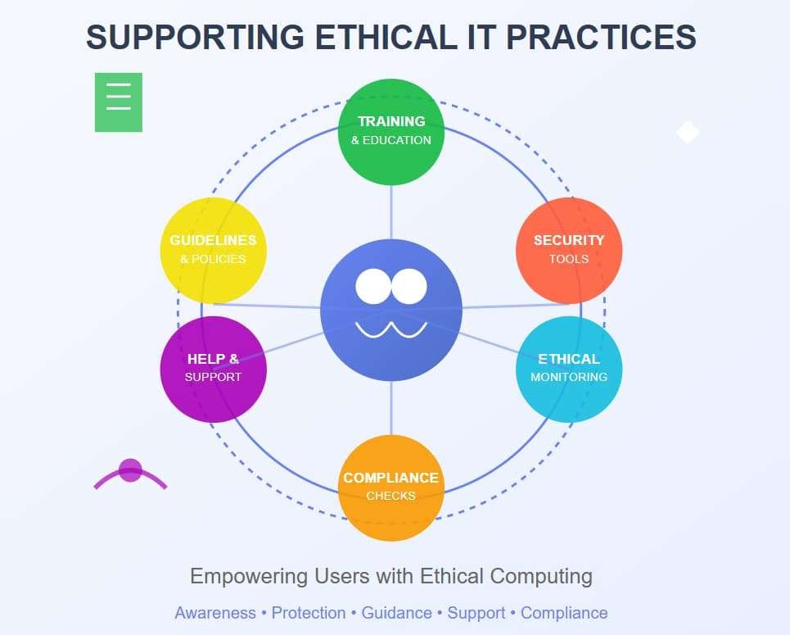
Supporting the Ethical Practices

Slide 15
Women Empowerment
Promoting gender equality in STEM fields.
2. Initiatives for women leadership in engineering.
3. Programs encouraging girls in technology.
4. Examples of empowered women in engineering.

Slide 16
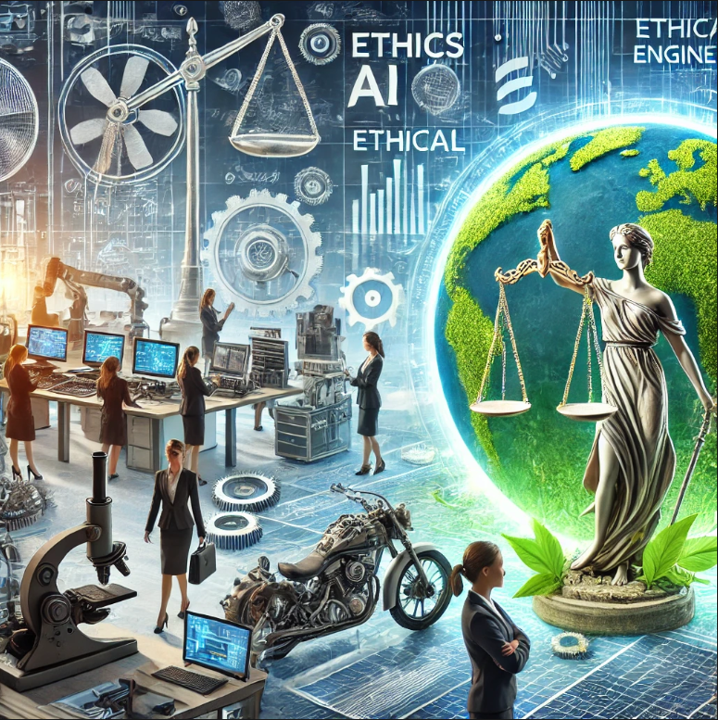

Women Empowerment

Slide 17
Ethical Aspects of Engineering Practices
1. Integrity and accountability in engineering.
2. Environmental sustainability in engineering projects.
3. Ensuring safety and reliability.
4. Recent ethical challenges in AI and automation.

Slide 18
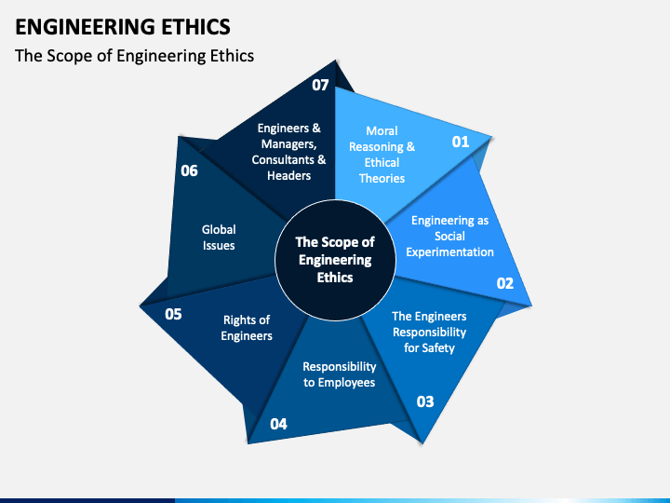

Slide 19
Recent Trends in Women Empowerment and Ethics
1. Rise of women-led startups in technology.
2. Increased focus on diversity in hiring policies.
3. Ethical AI design and its societal impact.
4. Inclusion of ethics in engineering curriculum.

